Slide 1
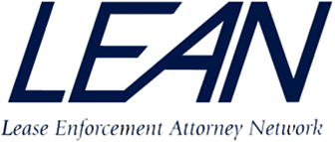
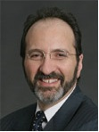
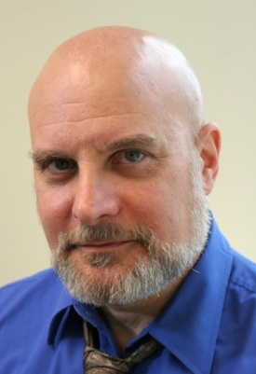
Being a Business Friendly Lawyer – Is This What Clients Really Want?
Moderator:
Robert S. Bernstein,
Bernstein-Burkley, P.C.,
Panelist:
Barry S. Marks, Esq.
Marks & Associates, P.C.
Robert Bernstein
Barry Marks

Slide 2
Robert S. Bernstein
LEAN member Bob Bernstein, Managing Partner at Bernstein-Burkley, P.C., has volunteered to moderate the webinar discussion.
Bob is a qualified member of the panel of the e-discovery special masters for the Federal Court in the Western District of Pennsylvania and has been involved in and managed the review of a production of more than 8 million pages of documents, as well as having managed the autopsies of a number of bankrupt companies as plan administrator or commercial counsel.
While fulfilling his duties as managing partner of Bernstein-Burkley, P.C., Bernstein represents other businesses of all sizes and types in many areas of their operation, including representation in reorganization proceedings. He has extensive experience in credit recovery matters, including collection, secured transaction and mortgage foreclosure.

Slide 3
Barry S. Marks
Barry Marks, founding shareholder of Marks & Associates, concentrates his practice in the areas of equipment leasing, commercial lending and finance and general business law. In addition to co-authoring multiple books and articles on leasing & leasing law, he is frequently invited to speak on business and commercial law issues.
Barry's professional honors & activities include being listed in The Best Lawyers in America® since 2005, holding an AV Peer Review "Preeminent" Rating (highest possible rating in both Legal Ability and Ethical Standards by LexisNexis/Martindale-Hubbell) and being honored as an Alabama Super Lawyer. He is Director Emeritas - National Association of Equipment Leasing Brokers, sits on the Board of Editors - Journal of Equipment Lease and Financing and the Board of Editors - LJN (formerly Leader's Equipment Leasing Newsletter). Barry is a Certified Lease Professional and a Member of the following: Equipment Leasing and Finance Association, National Association of Equipment Leasing Brokers, American Bar Association and the Alabama State Bar.

Slide 4
Outside Counsel (As opposed to Inhouse Counsel) Perspective
The “Gunslinger” vs The “Chum”

Slide 5
Common Client Complaints – Failure to Communicate
Poor responsiveness (the most frequent complaint)
Returning calls and emails in a timely manner
Failure to keep clients updated
Surprising or confusing bills

Slide 6
Common Client Complaints – Failure to Understand
Client business
Client terminology
Client priorities
“Follow the dollars”
Aversion to risk or cost

Slide 7
Common Client Complaints – Fees
Surprising or confusing billing
More common than amount of bill
Facilitate reserves and budgets
Lack of flexibility in billing
Fixed vs. hourly fees
Estimates, ceilings and floors
Ethical concerns
Unnecessary costs/disbursements
Computer research (which cost?)
Copies, courier service, long distance

Slide 8
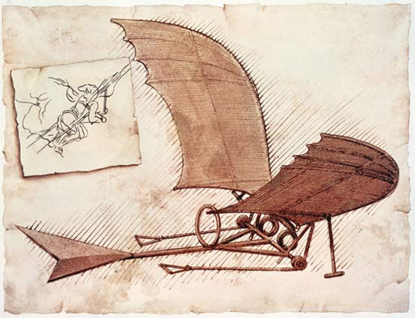
Common Client Complaints – Lack of Innovation and Experience
Failure to facilitate transaction
Adherence to form documents
Legalese v. Plain English
Unnecessary documentation
Retain independence and objectivity
Be honest about prospects
Ethical issues

Slide 9
Common Client Complaints – Poor Business Sense
Lack of timeliness, failure to:
Set and meet deadlines
Warn of delays
Be time-sensitive
Respect client policies and guidelines
Don’t make enemies of client customers

Slide 10
Common Client Complaints – Refusal to Partner with In-House Counsel
Don’t compete
Limit contact with business personnel
Educate in-house counsel
Respect in-house counsel
Be honest as to expectations
Don’t embarrass counsel
Keep counsel informed

Slide 11
What Clients Want is Business-Friendly Lawyering!

Slide 12
Words of Wisdom
Louis Brandeis: "A lawyer who has not studied economics and sociology is very apt to become a public enemy."
Abraham Lincoln: "A lawyer's time and advice are his stock in trade."
Daniel Webster: "Our profession is good if practiced in the spirit of it; it is damnable fraud and iniquity when its true spirit is supplied by a spirit of mischief-making and money-getting."

Slide 13
We Must Learn to:
Facilitate deals
Problem-spotting is worth a dollar, Problem solving? Ten!
Be in business
But not in business for ourselves
Partner with in-house counsel and clients to get deals done

Slide 14
The only nationwide network of law firms specializing in lease enforcement and recovery
Legal expertise
Strategic locations
Cost effective solutions
Find out how LEAN can help your bottom line.
Call 877-LEASE-LAW for a complimentary referral
or visit us at www.leasecollect.org.

Slide 15
Q & A
Thank you!

